Slide 1
Spill over
UNIT V (PUNCTUATION)

Slide 2
Q1. Punctuate the following sentences.
All of the people at the school, including the teachers and were glad when summer break came.
  students:
  students,
  students;
  students

Slide 3
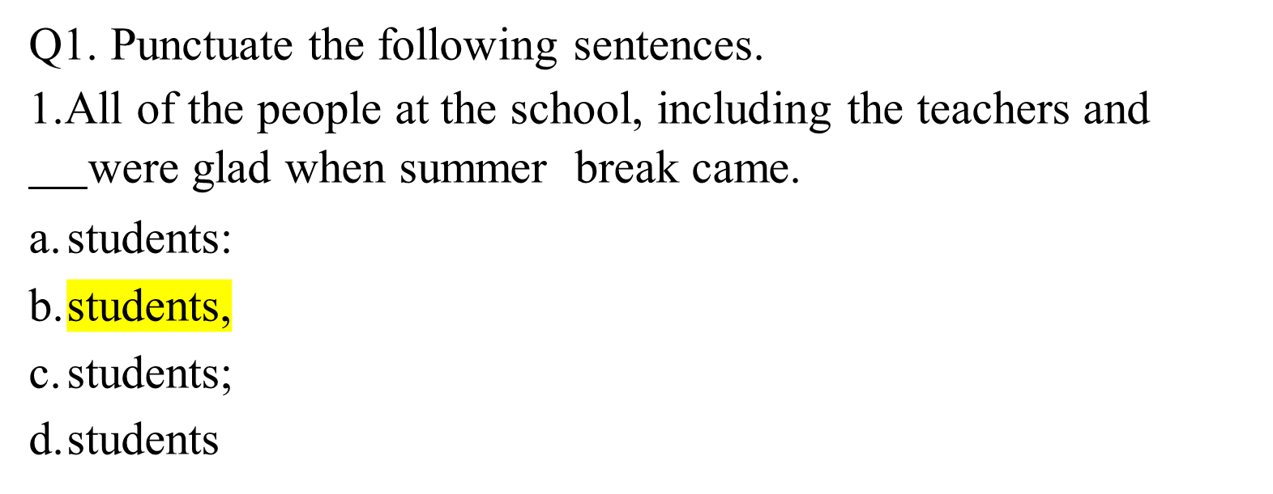

Slide 4
Sit up straight
  ;
  ?
  .
  :

Slide 5
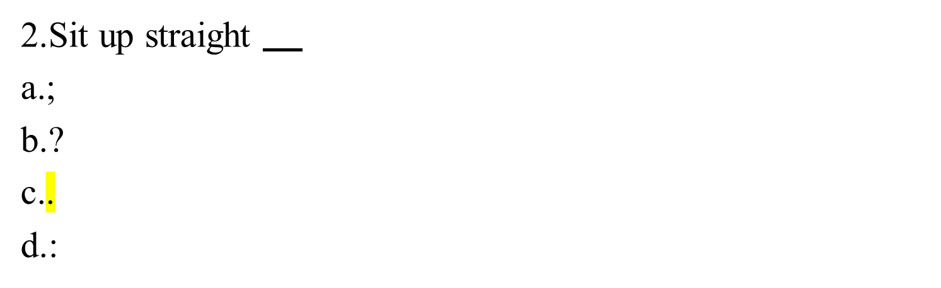

Slide 6
They asked what time the department store would open
  ?
  .
  ,
  ;

Slide 7
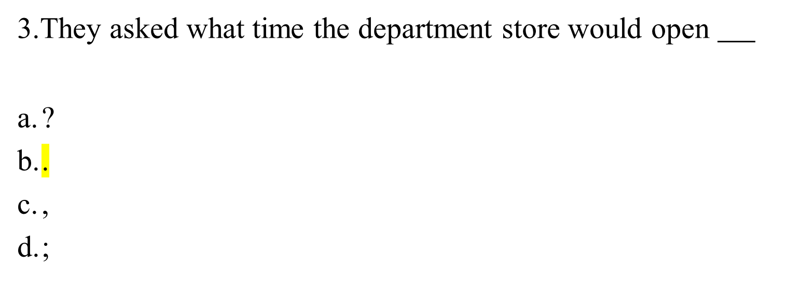

Slide 8
Who do you think will win the contest
  .
  !
  ?
  ,

Slide 9
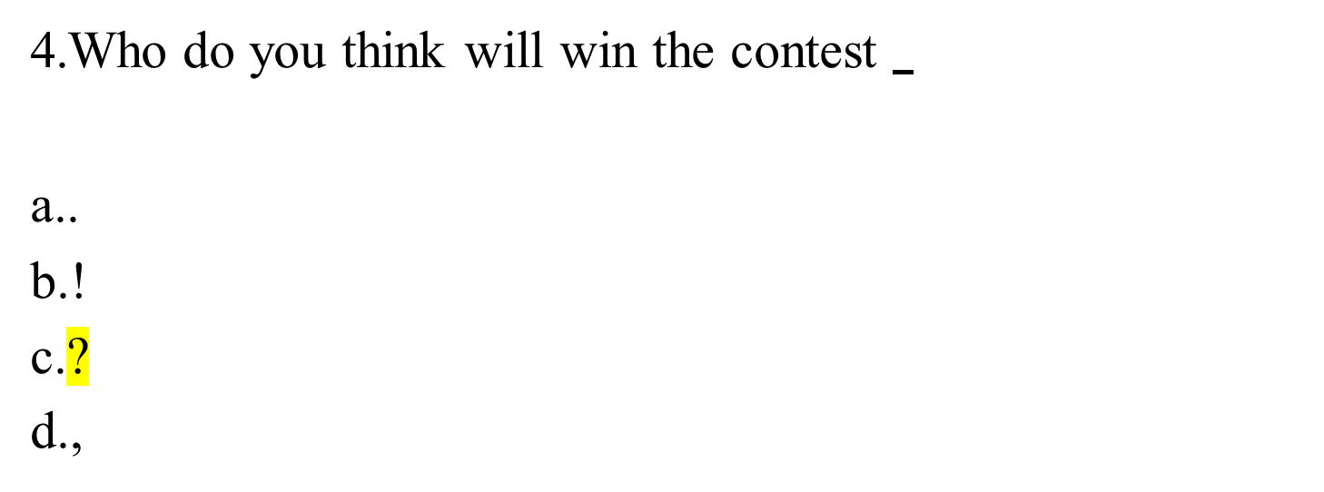

Slide 10
Choose the sentence below with the correct punctuation.
  Ted and Janice, who had been friends for years, went on vacation together every summer.
  Ted and Janice, who had been friends for years, went on vacation together, every summer.
  Ted, and Janice who had been friends for years, went on vacation together every summer.
  Ted and Janice who had been friends for years went on vacation together every summer.

Slide 11
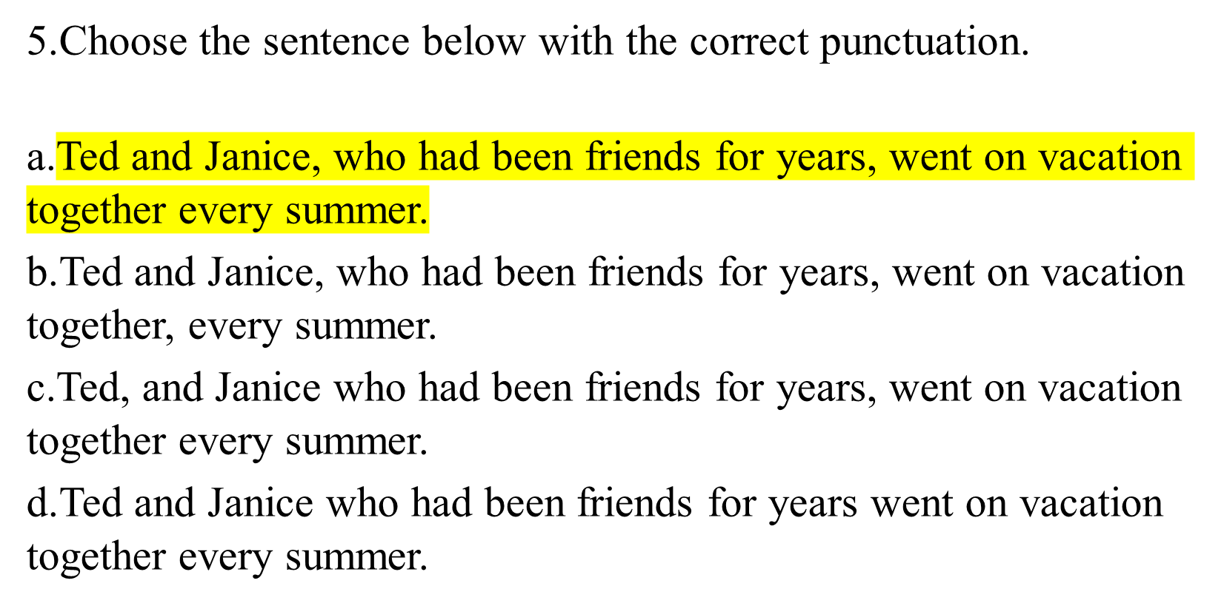

Slide 12
To , Anne was on time for her math class.
  everybody’s surprise
  every body’s surprise
  everybodys surprise
  everybodys’ surprise

Slide 13
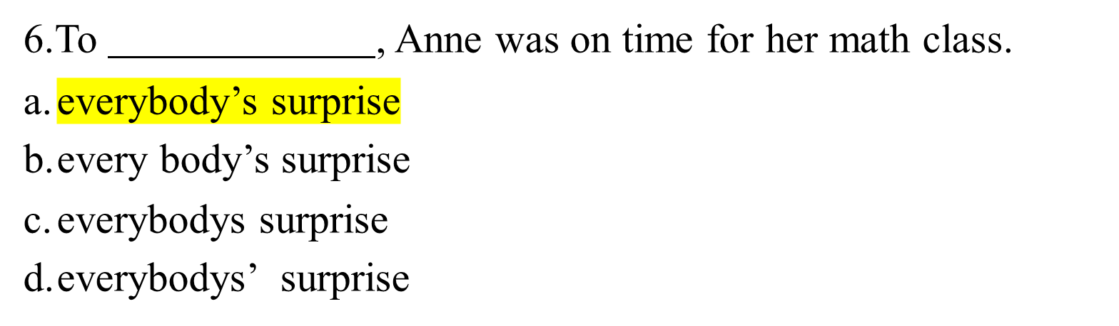

Slide 14
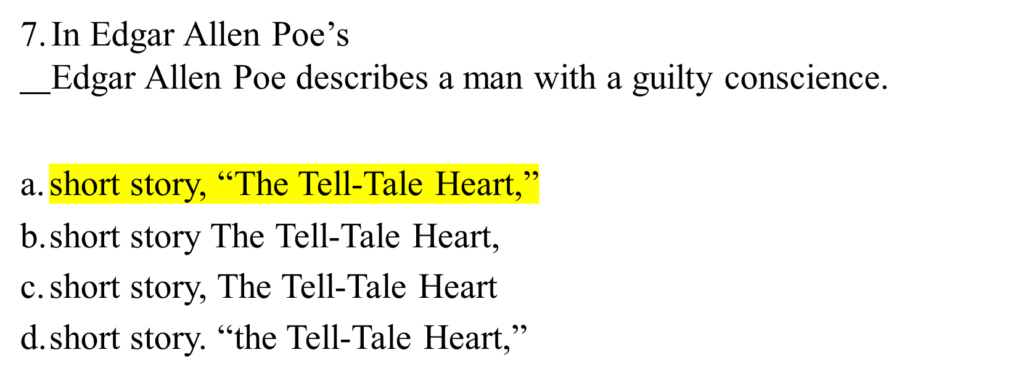

Slide 15
Billboards are considered an important part of advertising for big business,
by their critics.
  but, an eyesore;
  but, “ an eyesore,”
  but an eyesore
  but-an eyesore

Slide 16
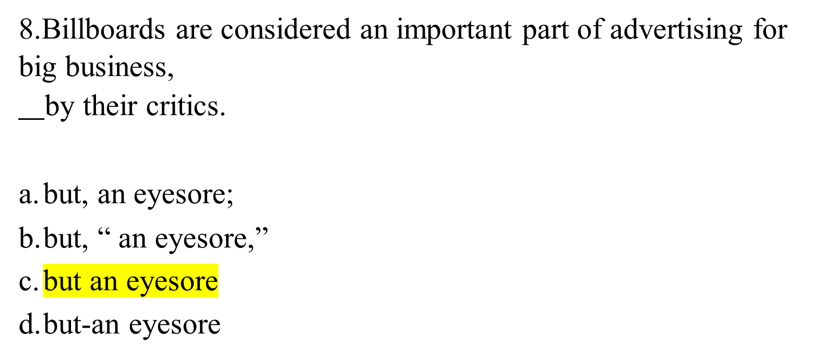

Slide 17
I can never remember how to use those two common words, “sell,” meaning to trade a product for money, or meaning an event where products are traded for less money than usual.
  sale.
  “sale,”
  “sale
  “to sale,”

Slide 18
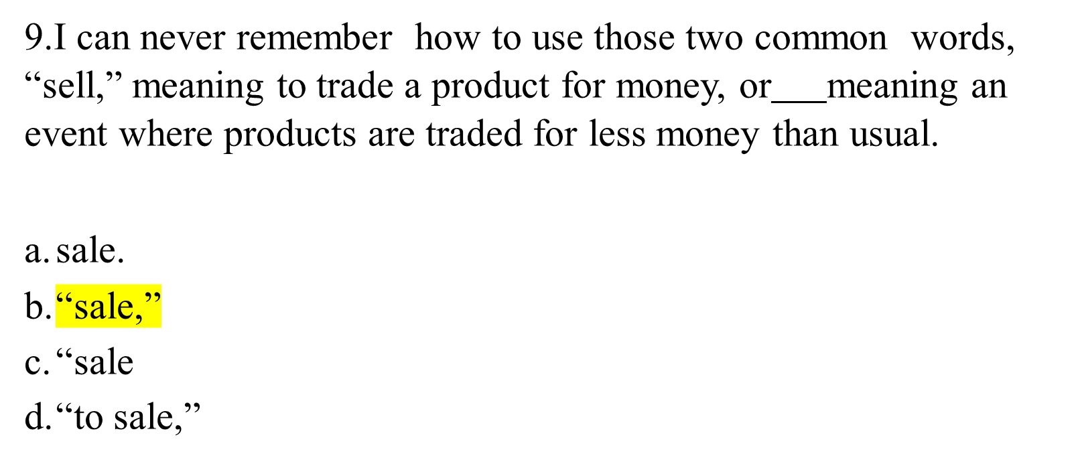

Slide 19
10. The class just finished reading
a short story by Carl Stephenson about a plantation owner’s battle with army ants.
-”Leinengen versus the Ants”,
Leinengen versus the Ants,
“Leinengen versus the Ants,”
Leinengen versus the Ants

Slide 20
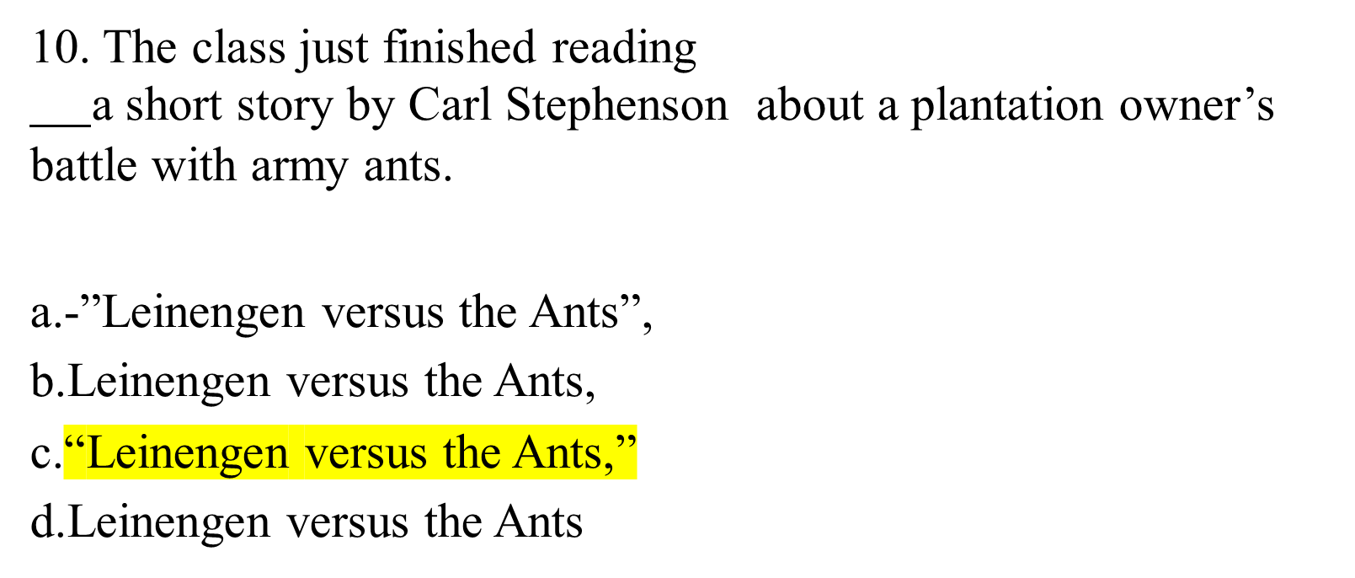

Slide 21
11. This is absolutely incredible
!
.
:
;

Slide 22
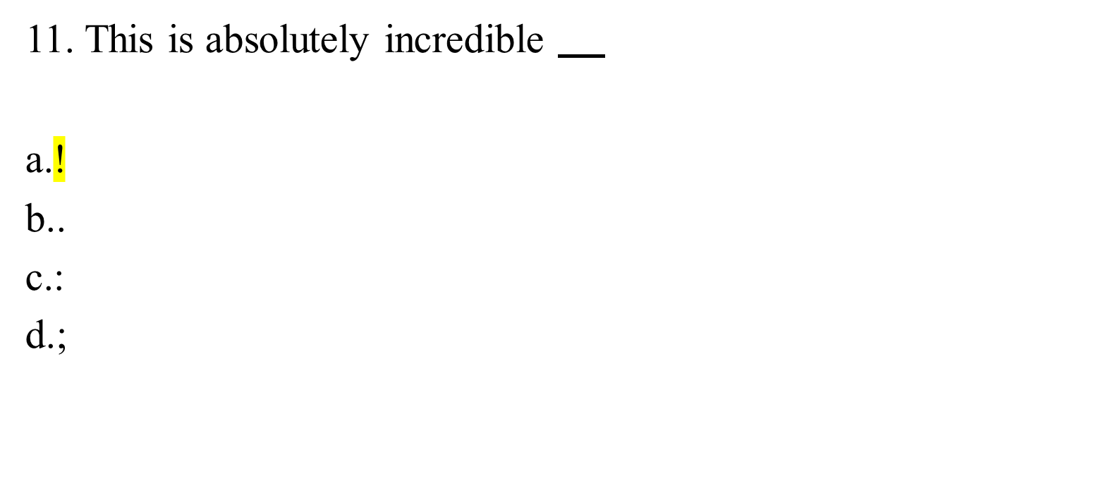

Slide 23
12. Watch out for the broken glass
.
?
,
!

Slide 24
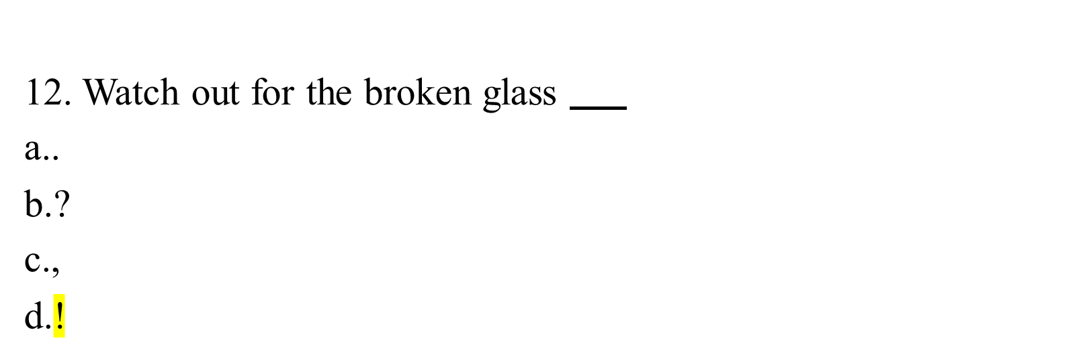

Slide 25
Put in semicolons, colons, dashes, quotation marks, Italics (use an underline), and parentheses where ever they are needed in the following sentences.
1. The men in question Harold Keene, Jim Peterson, and Gerald Greene deserve awards.

Slide 26
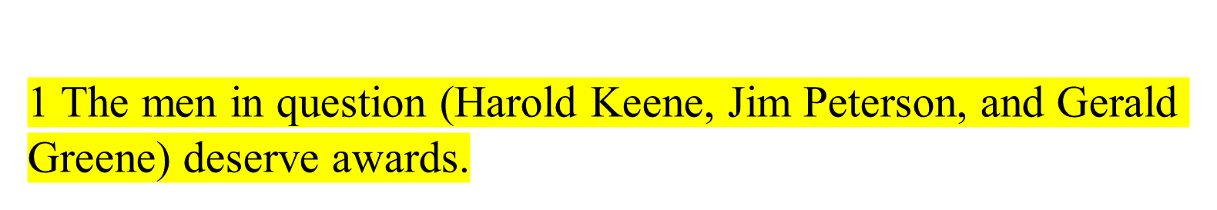

Slide 27
2. Several countries participated in the airlift Italy, Belgium, France, and Luxembourg.

Slide 28
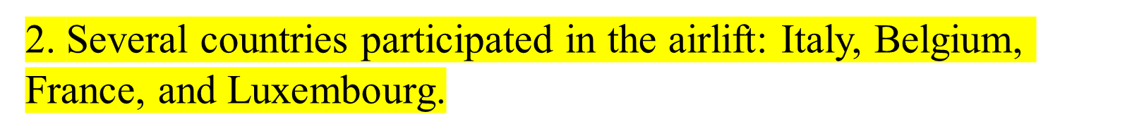

Slide 29
3. There's no room for error, said the engineer so we have to double check every calculation.

Slide 30
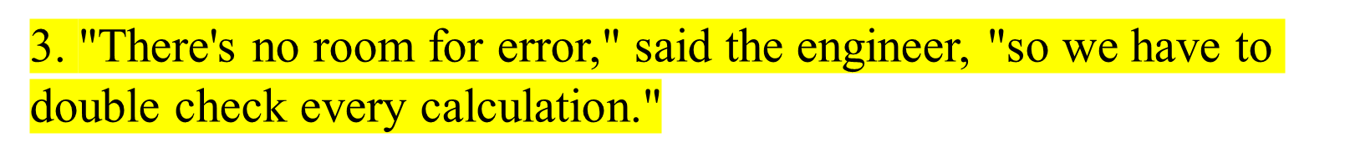

Slide 31
4. Judge Carswell later to be nominated for the Supreme Court had ruled against civil rights.

Slide 32
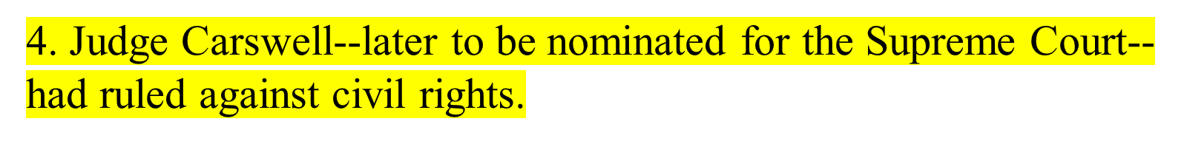

Slide 33
5. In last week's New Yorker, one of my favorite magazines, I enjoyed reading Leland's article How Not to Go Camping.

Slide 34
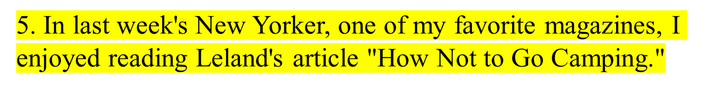

Slide 35
6. Yes, Jim said, I'll be home by ten.

Slide 36


Slide 37
7. There was only one thing to do study till dawn.

Slide 39
8. Montaigne wrote the following A wise man never loses anything, if he has himself.

Slide 40
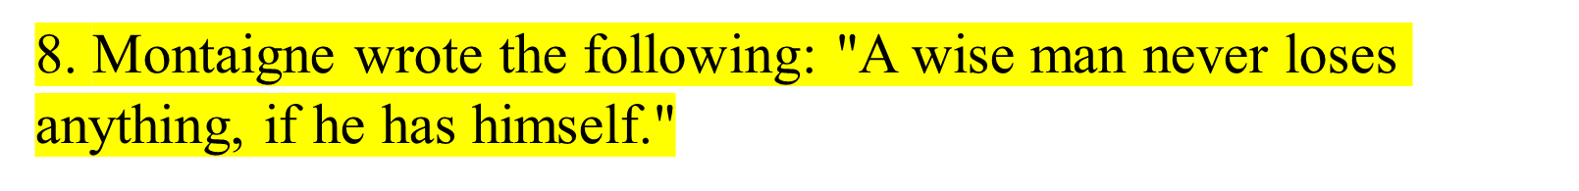

Slide 41
9. The following are the primary colors red, blue, and yellow.

Slide 43
10. Arriving on the 8 10 plane were Liz Brooks, my old roommate her husband and Tim, their son.

Slide 44
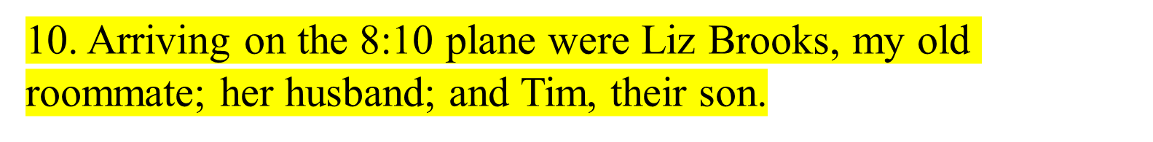

Slide 45
11. When the teacher commented that her spelling was poor, Lynn replied All the members of my family are poor spellers. Why not me?

Slide 46
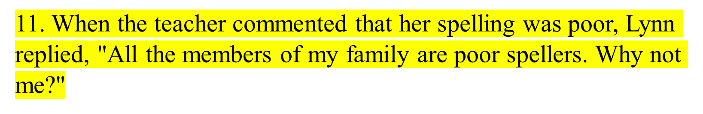

Slide 47
12. He used the phrase you know so often that I finally said No, I don't know.

Slide 48
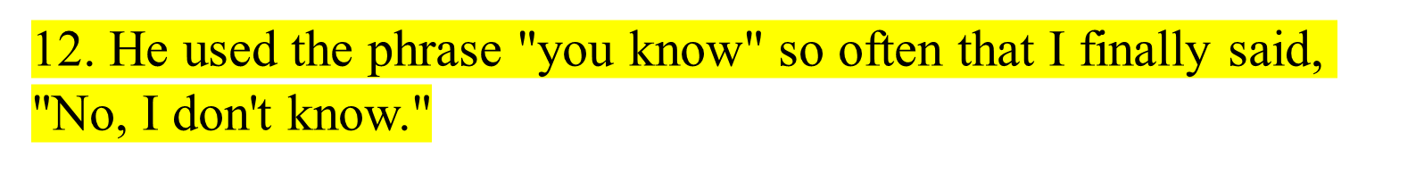

Slide 49
13. The automobile dealer handled three makes of cars Volkswagens, Porsches, and Mercedes Benz.

Slide 50
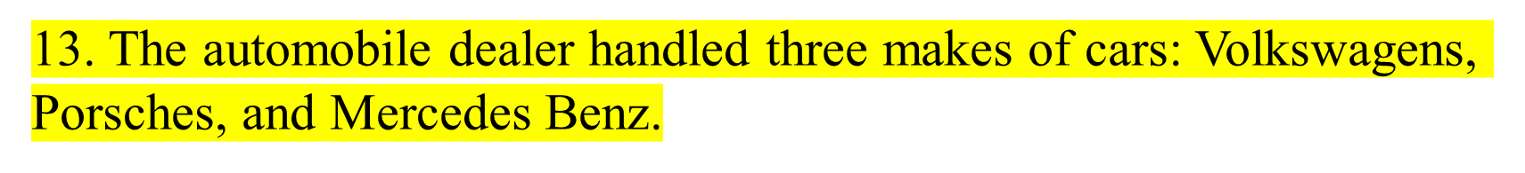

Slide 51
14. Though Phil said he would arrive on the 9 19 flight, he came instead on the 10 36 flight.

Slide 52
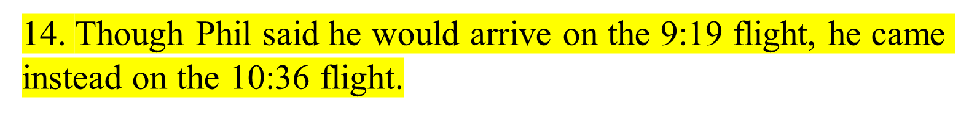

Slide 53
15. Whoever thought said Helen that Jack would be elected class president?

Slide 54
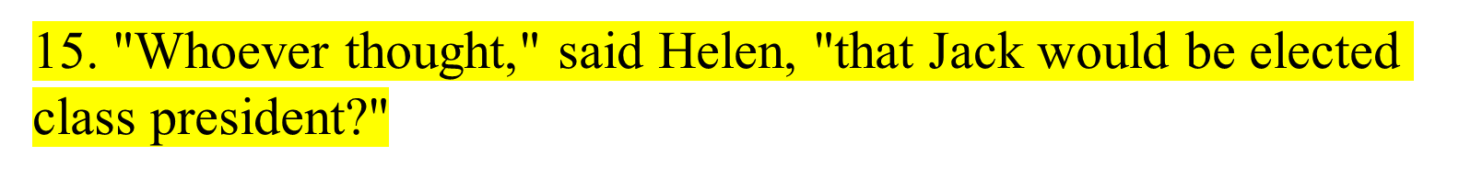

Slide 55
16. In baseball, a show boat is a man who shows off.

Slide 57
17. The minister quoted Isaiah 5 21 in last Sunday's sermon.

Slide 59
18. There was a very interesting article entitled The New Rage for Folk Singing in last Sunday's New York Times newspaper.

Slide 60
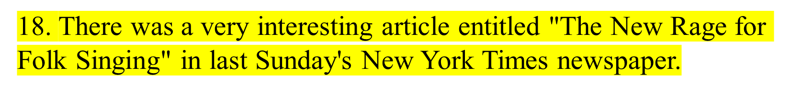

Slide 61
19. Whoever is elected secretary of the club Ashley, or Chandra, or Aisha must be prepared to do a great deal of work, said Jumita, the previous secretary.

Slide 62
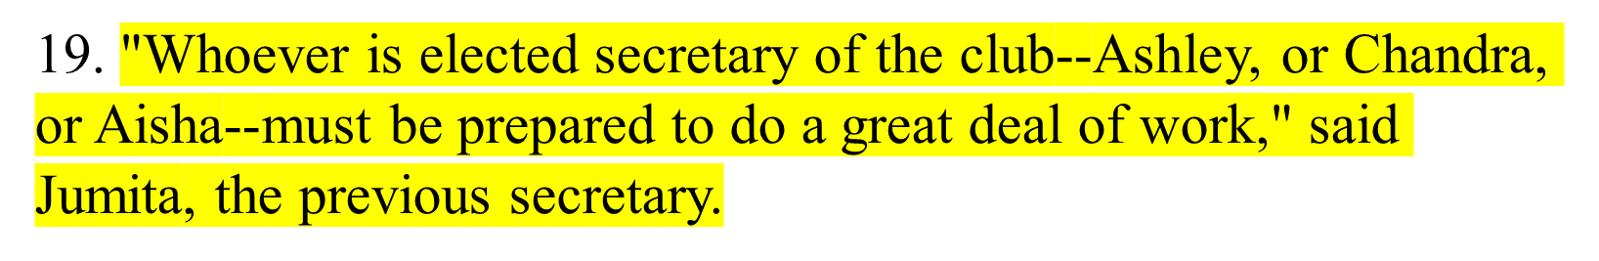

Slide 63
20. Darwin's On the Origin of Species 1859 caused a great controversy when it appeared.

Slide 64
